Slide 1
PC Maintenance: Preparing for A+ Certification
Chapter 20: Portable PCs

Slide 2
Chapter 20 Objectives
Differentiate types of portable PCs
Identify key features of notebooks, PDAs
Work with PC Card devices
Configure power management
Create and manage hardware profiles
Troubleshoot common problems

Slide 3
Types of Portable Computers
Notebook
Subnotebook
PDA
Cell phone

Slide 4
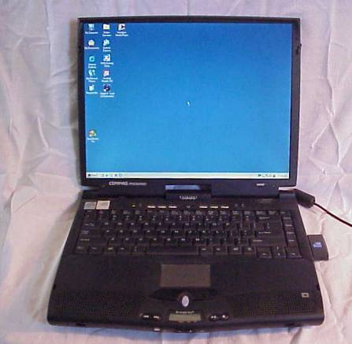
Features of Notebook Computers
LCD screen
  Similar to a stand-alone LCD monitor

Slide 5

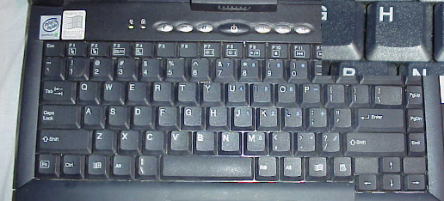
Features of Notebook Computers
Fn key
  Combines with other keys to allow for more key functions

Slide 6
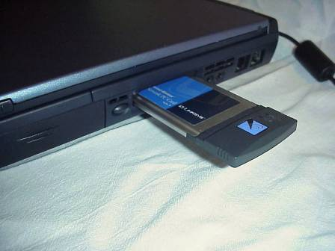
Features of Notebook Computers
PC Card slots
  Type I
    RAM
  Type II
    Expansion cards
  Type III
    Drives
CardBus: modern standard for PC Card

Slide 7
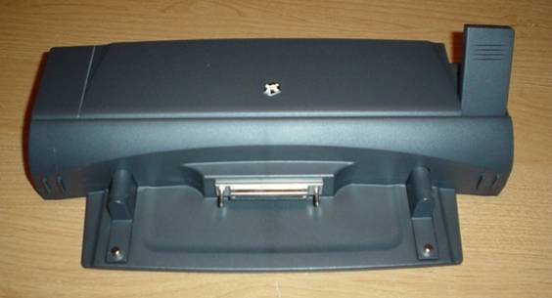
Docking Station
Provides more ports and capabilities
Quick connect/disconnect

Slide 8
Battery Types
Nickel Cadmium (NiCad)
  Older technology
  Heavy metals, toxic
  3-4 hour life
  Subject to problems with partial draining and recharging

Slide 9
Battery Types
Nickel-Metal Hydride (NiMH)
  Do not use heavy metals
  Up to 50% more life than NiCad
  No problems with partial draining
Lithium Ion (LIon)
  Lightweight, long life
  No problems with partial draining
  No poisonous metals
  More expensive than others

Slide 10
Batteries
Precautions
  Same as with regular alkaline batteries
  No extreme heat and cold
  Do not get battery wet
  If leaking, avoid touching the discharge
Charging a Battery
  Put it in the PC and plug in the AC power cord
  Full charge might take 4 hours or more

Slide 11
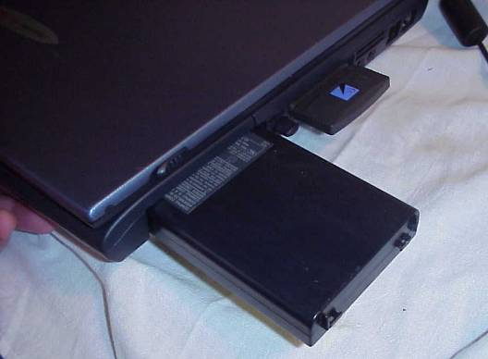
Batteries
Removing a battery
  Consult instructions for exact model of PC
  Usually behind a panel or cover

Slide 12
Infrared Ports
Common on notebooks, PDAs
Standard defined by Infrared Data Association (IrDA)
Connect to other IrDA-equipped devices
Short distance, must have line of sight
Enable/disable IR support in BIOS Setup

Slide 13
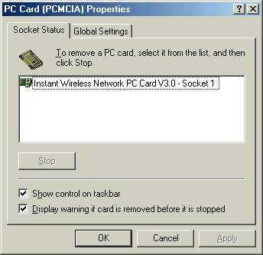
Managing PC Cards in Windows
From Control Panel, PC Card (PCMCIA)
Stop a device before removing it (Stop button)

Slide 14
Power Management for Notebook PCs
Advanced Power Management (APM)
  Older standard
  Deals mainly with monitor and hard drives
Advanced Configuration and Power Interface (ACPI)
  Newer, more compehensive
  Covers monitor, hard drives, CPU, peripherals
  Better to use, if available

Slide 15
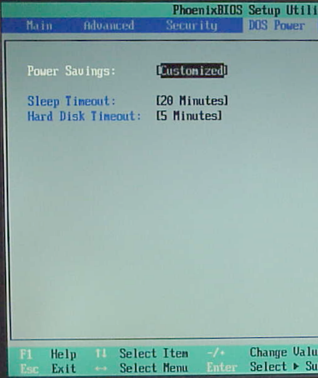
Power Options in BIOS Setup
Use only if Windows power management not available, to avoid conflicts

Slide 16
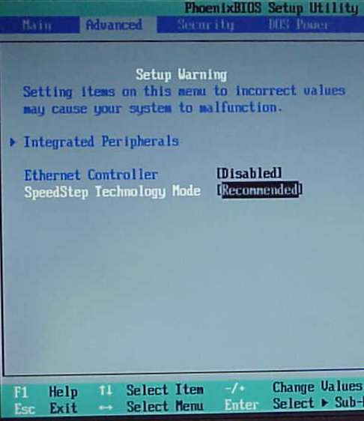
SpeedStep Technology
Enables notebook to use lower CPU speed when on batteries
Enable/disable in BIOS Setup

Slide 17
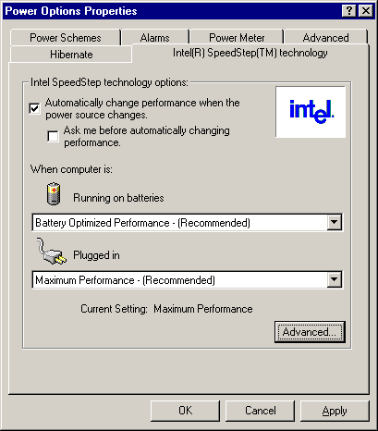
SpeedStep Technology
If enabled in BIOS, can be enabled/disabled in Windows

Slide 18
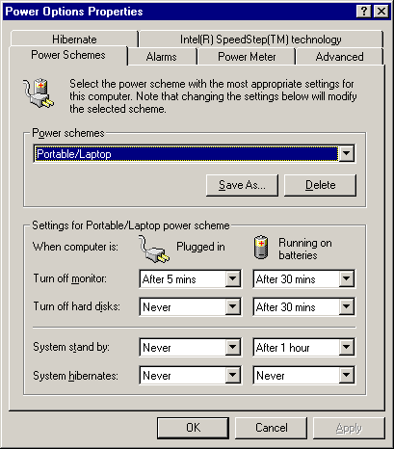
Power Options in Windows
Customizable power schemes
Separate settings when plugged in versus on batteries

Slide 19
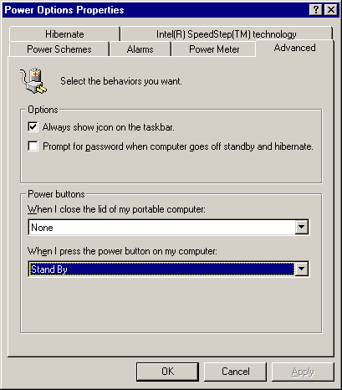
Power Options in Windows
Control behavior of power button and lid closing
  Stand By
  Hibernate
  Turn Off
  None

Slide 20
Stand By
Shuts off most parts of the PC
Leaves RAM powered up, so it can retain its contents
Makes battery last much longer, but eventually runs out
Resuming from Stand By is very quick

Slide 21
Hibernate
Copies contents of RAM to hard disk
Shuts down completely (so no power is needed to maintain)
Resuming from Hibernate copies data back into RAM from hard disk
Still fairly quick, but not as quick as from Stand By

Slide 22
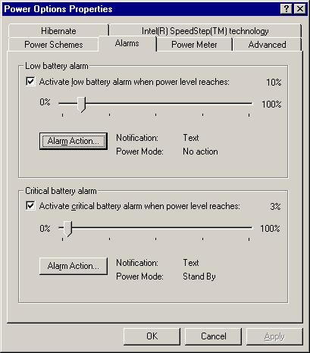
Power Alarms
Trigger when battery becomes low
Customizable in power level and in action to take

Slide 23
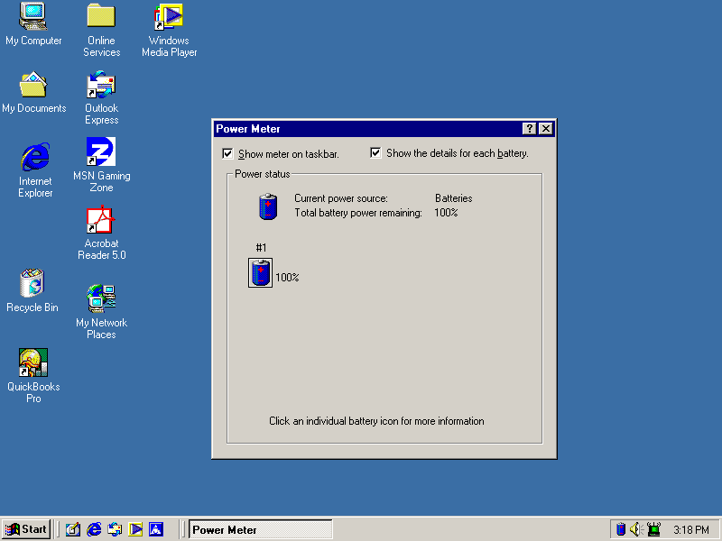
Power Meter
Icon in
system tray

Slide 24
Hardware Profiles
Tells Windows what hardware should be installed
Useful when a computer sometimes has different hardware installed
  Docking station usage
  Enabling network card at certain times
  External keyboard/mouse/monitor

Slide 25
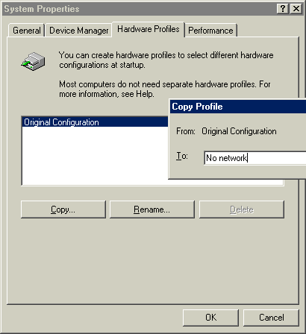
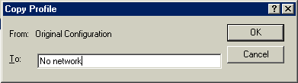
Creating a Hardware Profile
Copy an existing hardware profile

Slide 26
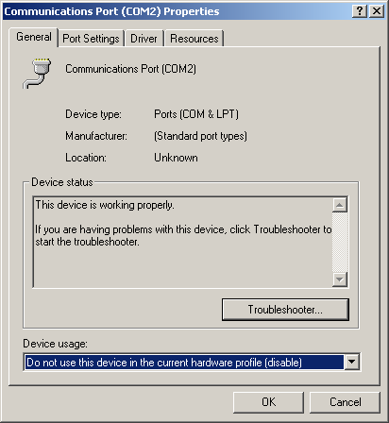
Creating a Hardware Profile
Boot the system into the new profile
Make hardware changes in Device Manager, such as disabling a device
Disable a device

Slide 27
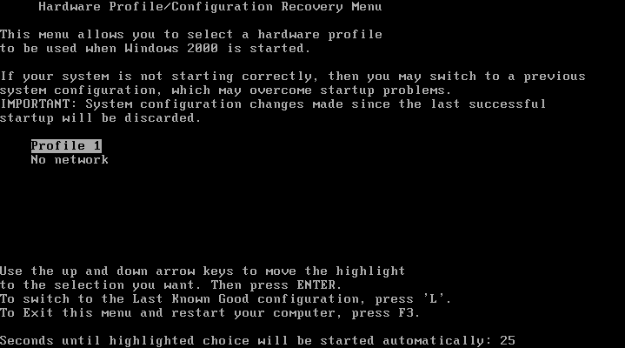
Switching Between Profiles
Choose from the menu at startup

Slide 28
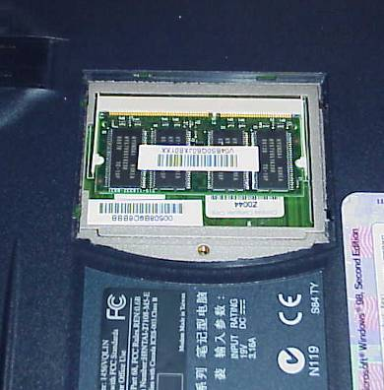
Adding RAM to a Notebook
Locate RAM socket and remove cover
Remove existing RAM from socket if any
Insert new RAM

Slide 29
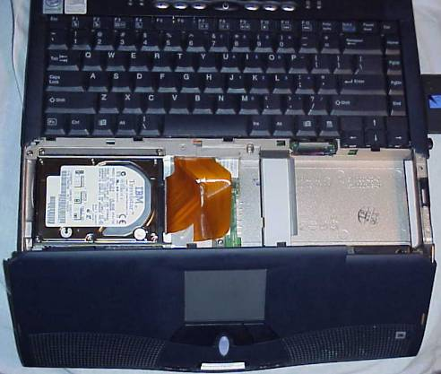
Replacing a Hard Drive
Read manual
Open PC
Disconnect data cable
Insert and secure new drive
Connect data cable

Slide 30
Troubleshooting Display Problems
Black ring around picture
  Run in higher resolution
  Set display to fill entire screen
Dead pixels
  Return if still under warranty

Slide 31
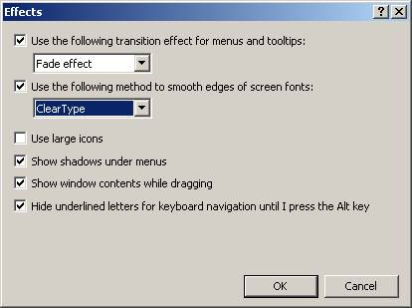
Problems with Fuzzy Text
Run in higher resolution
Enable ClearType
  Display properties, Appearance, Effects

Slide 32
Power Problems
Will not go into Standby or Hibernate
  Do not use OpenGL-type screen saver
  Do not use standard VGA video driver
  Close open programs that might be preventing shutdown
  Disconnect USB devices that might be preventing shutdown
  Use Power Management Troubleshooter from Microsoft

Slide 33
Power Problems
Will not wake up from Standby or Hibernation
  Wait. Some take up to 30 seconds to awaken
  Look for a Suspend or Hibernate key
  Press and hold power button for 5 seconds
  Consult PC’s documentation for a key combination for wake-up
  Remove batteries, unplug, wait a few minutes, then replace batteries and boot

Slide 34

Personal Digital Assistant (PDA)
Touch-sensitive screen
Hardware buttons
Buttons on touch-screen
Power button
Scroll buttons

Slide 35
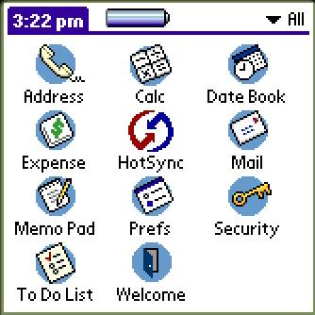
PDA Operating Systems
Windows CE
Palm OS
(shown here)

Slide 36
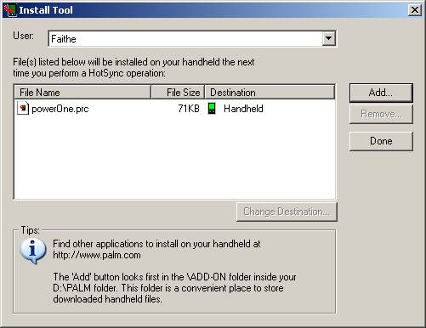
Installing New Programs on a PDA
A PC is required
Connect PDA to PC
Run software install utility for PDA on PC

Slide 37
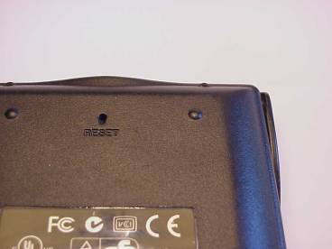
Troubleshooting PDAs
Blank screen
  Check contrast
  Make sure batteries are not dead
  Reset
Locked up
  Reset
  Consult manual to find reset button or switch

Slide 38
Troubleshooting PDAs
Locks up even after reset
  Hard reset (consult manual)
Will not run a certain program
  Check program’s requirements
  Update PDA’s BIOS

